Slide 1
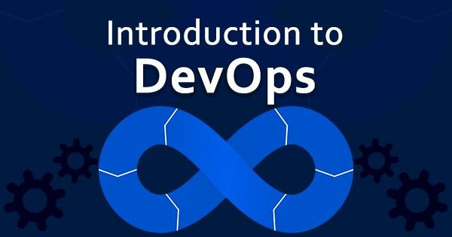
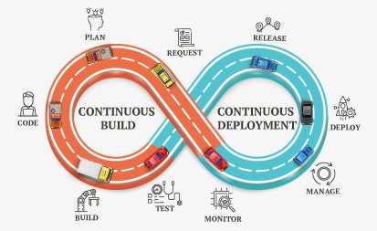


05-04-2025
Dr. S.Udhayakumar
Professor, Department of Computer Science and Engineering mailtoudhay@gmail.com
Course Objectives
No | Objective
CO1 | To learn the key ideas and techniques to bring development and operations together to produce higher-quality software and deliver it more quickly.
CO2 | To learn the core principles, business and technical terms used in DevOps from perspective of business and IT teams
CO3 | To gain knowledge of the Principles and practices of the DevOps Lifecycle including Continuous Integration, Continuous Inspection, Continuous delivery, Continuous deployment and Continuous monitoring.
CO4 | To understand the usage of tools and technologies used for implementing DevOps.

Slide 2
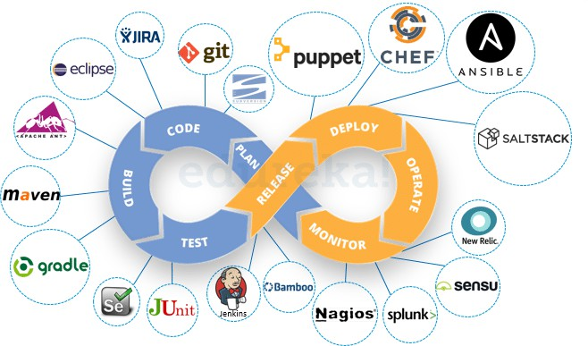

05-04-2025
Text books and References
No | Author(s), Title, Edition, Publishing House
T1 | DevOps: A Software Architect's Perspective (SEI Series in Software Engineering) by Len Bass, Ingo Weber, Liming Zhu , Publisher: Addison Wesley (18 May 2015).
T2 | Continuous Delivery: Reliable Software Releases through Build, Test, and Deployment Automation by Jez Humble, David Farley. Publisher: Addison Wesley, 2011
No | Author(s), Title, Edition, Publishing House
R1 | Effective DevOps: Building A Culture of Collaboration, Affinity, and Tooling at Scale by Jennifer Davis , Ryn Daniels. Publisher: O'Reilly Media, June 2016
R2 | The DevOPS Handbook: How to Create World-Class Agility, Reliability, and Security in Technology Organizations by Gene Kim, Patrick Debois, John Willis, Jez Humble, John Allspaw. Publisher: IT Revolution Press (October 6, 2016)
R3 | Web Resources: https://jenkins.io/ https://xebialabs.com/solutions/devops/ https://www.ibm.com/ibm/devops/us/en/casestudies/#all https://git-scm.com/ https://hub.docker.com/ https://www.atlassian.com/git/tutorials/comparing-workflows https://www.tutorialspoint.com/puppet/ https://www.tutorialspoint.com/chef/
Module 2: DevOps Dimensions
Three dimensions of DevOps – People, Process, Technology/Tools
DevOps- Process
DevOps and Agile
Agile methodology for DevOps Effectiveness
Flow Vs Non-Flow based Agile processes
Choosing the appropriate team structure: Feature Vs Component teams
Enterprise Agile frameworks and their relevance to DevOps
Behaviour driven development, Feature driven Development
Cloud as a catalyst for DevOps DevOps – People
Team structure in a DevOps
Transformation to Enterprise DevOps culture
Building competencies, Full Stack Developers
Self-organized teams, Intrinsic Motivation Technology in DevOps(Infrastructure as
code, Delivery Pipeline, Release Management)
Tools/technology as enablers for DevOps
RL2.1 Pillars of DevOps
RL2.1.1 Three dimensions of DevOps – People, Process, Technology/Tools RL2.1.2 DevOps Misconception
RL2.1.3 Agile Methodology - Scrum RL2.2 DevOps- Process
RL2.2.1 DevOps and Agile
RL2.2.2 Agile methodology for DevOps Effectiveness
Behavior Driven Development, Feature Driven Development and Test Driven Development
RL2.3 DevOps – People
RL2.3.1 Team structure in a DevOps
RL2.3.2 Transformation to Enterprise DevOps culture RL2.3.3 DevOps Culture
RL2.4 DevOps-Tools
RL2.4.1 Tools and Technology in DevOps RL2.4.2 Cloud as a catalyst for DevOps

Slide 3
05-04-2025
Agenda
DevOps Misconceptions and Dimensions
DevOps Misconceptions
DevOps Antipatterns
Three Dimensions of DevOps
DevOps Misconceptions
DevOps Only Involves Developers and System Administrators
As the name indicates Development and Operations
However the Truth is:
DevOps tagline is bring development and operations together
The concepts and ideas of DevOps include all roles within an organization
There is no definitive list of which teams or individuals should be involved
Any team within the organization should be considered as a candidate for DevOps, it may include security, QA, support, and legal

Slide 4
05-04-2025
DevOps Misconceptions Contd..
DevOps is a Team
Creating a team called DevOps, OR
Renaming an existing team to DevOps is neither necessary nor sufficient for creating a DevOps culture
However truth is:
An additional team is likely to cause more communication issues, not fewer
the development and operations teams must connect frequently or it should work together
In a startup environment, having a single team that encompasses both functions can work
DevOps Misconceptions Contd..
DevOps is a Job Title
The “DevOps engineer” job title has started a controversial debate
The job title has been described in various ways
A system administrator who also knows how to write code
A developer who knows the basics of system administration
However truth is:
In DevOps it makes sense to have people become more specialized in their job role
DevOps is at its core a cultural movement, and its ideas and principles need to be used throughout entire organizations in order to be effective

Slide 5
05-04-2025
DevOps Misconceptions Contd..
You Need a DevOps Certification
Certification exams are testing knowledge where there are clear right or wrong answers, which DevOps generally does not have
However truth is:
A significant part of DevOps is about culture: how do you certify culture?
DevOps doesn’t have required technology or one-size-fits-all solutions
DevOps Misconceptions Contd..
DevOps Means Doing All the Work with Half the People
Get both a software developer and a system administrator in one person and with one person’s
salary
However truth is:
Not only is this above perception incorrect, but it is often harmful
At a time startups are offering perks such as three meals a day in the office and on-site laundry as a way of encouraging
DevOps doesn’t save money by halving the number of engineers your company needs
Rather, it allows organizations to increase the quality and efficiency of their work

Slide 6
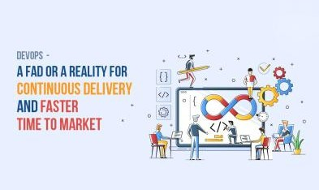
05-04-2025
DevOps Misconceptions Contd..
DevOps Is About Automation
Many innovations in DevOps-adjacent tools help to codify understanding, bridging the gaps between teams and increasing velocity through automation
Practitioners have focused on tools that eliminate tasks that are boring and repetitive, such as with infrastructure automation and continuous integration.
However truth is:
In both of these above cases, automation is a result of improved technology
Automating repetitive tasks automation will help to human from having to do them, that automation helps that person work more efficiently
Example: Automating server builds saves hours per server that a system administrator can then spend on more interesting or challenging work
DevOps Misconceptions Contd..
DevOps Is a FAD
It’s a Buzzword in Market
Just a new word in place
However truth is:
As DevOps is not specific to a technology, tool, or process however, It is movement about improving organizational effectiveness and individual employee happiness
One of the primary differences between DevOps and methodologies like ITIL and Agile is:
It does not have strict definition
DevOps is movement defined by stories and ideas of individuals, teams, and organizations
DevOps is the evolution of processes and ideas that lead growth and change
Harnessing and leveraging effective DevOps will lead to growth and evolution in tools, technology, and processes in your organization

Slide 7
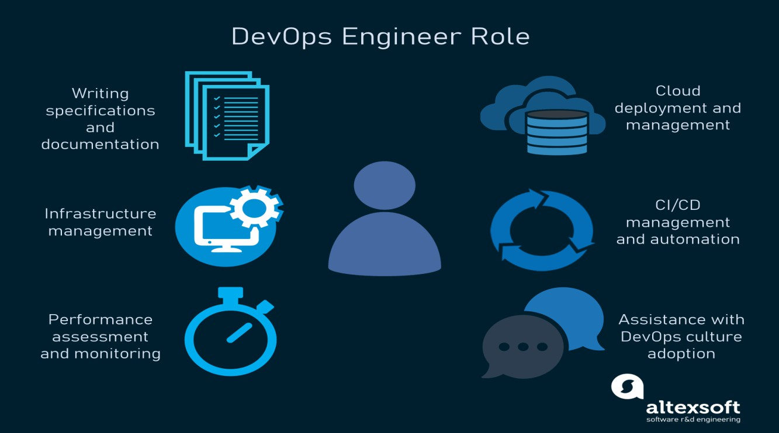
05-04-2025
DevOps Anti-Patterns
Blame Culture
A blame culture is one that tends toward blaming and punishing people when mistakes are made, either at an individual or an organizational level
Silos
A departmental or organizational silo describes the mentality of teams that do not share their knowledge with other teams in the same company
Root Cause Analysis
Root cause analysis (RCA) is a method to identify contributing and “root” causes of events or near- misses/close calls and the appropriate actions to prevent recurrence
Human Errors
Human error, the idea that a human being made a mistake that directly caused a failure, is often cited as the root cause in a root cause analysis

Slide 8
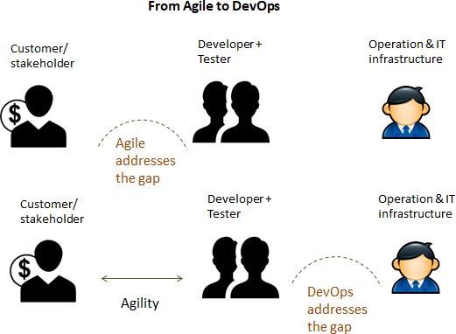
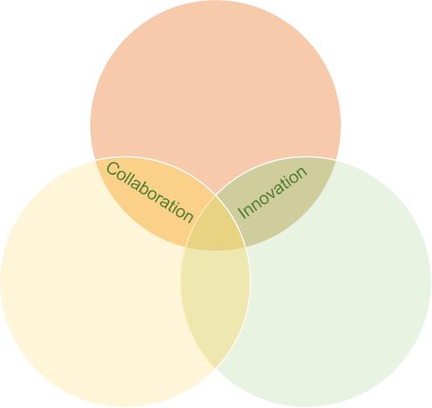
05-04-2025
Three dimensions of DevOps
3-D of DevOps
People
Process
Tools / Technology
People
DevOps
Process
Automation
Tools

Slide 9
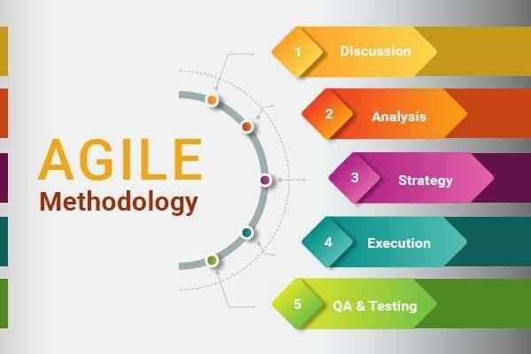
05-04-2025
What is Agile Methodology?
An agile methodology is an iterative approach to software development.
Each iteration of agile methodology takes a short time interval of 1 to 4 weeks.
The agile development process is aligned to deliver the changing business requirement.
It distributes the software with faster and fewer changes.
•
The single-phase software development takes 6 to 18 months.
In single-phase development, all the requirement gathering and risks management factors are predicted initially.
The agile software development process frequently takes the feedback of workable product.
The workable product is delivered within 1 to 4 weeks of iteration.

Slide 10
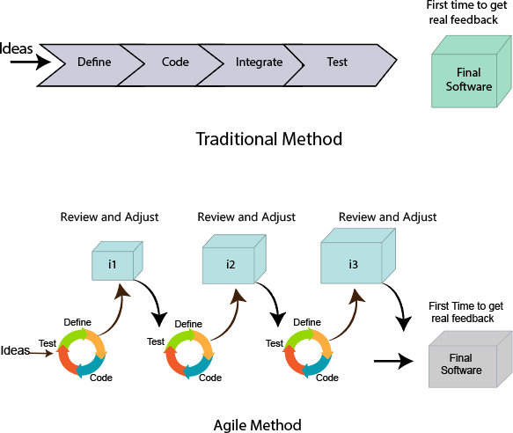
05-04-2025
Roles in Agile: 1. Scrum Master
There are two different roles in a Agile methodology. These are the Scrum Master and Product Owner.
The Scrum Master is a team leader and facility provider who helps the team member to follow agile practices, so that the team member meets their commitments and customers requirements. The scrum master plays the following responsibilities:
They enable the close co-operation between all the roles and functions.
They remove all the blocks which occur.
They safeguard the team from any disturbances.
They work with the organization to track the progress and processes of the company.
They ensure that Agile Inspect & Adapt processes are leveraged correctly which includes
Planned meetings
Daily stand-ups
Demo
Review
Retrospective meetings, and
Facilitate team meetings and decision-making process.

Slide 11
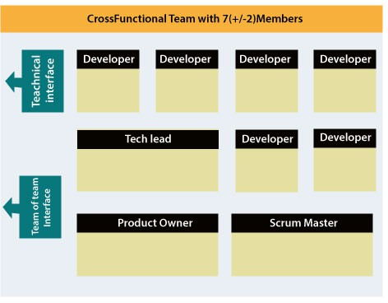
05-04-2025
Roles in Agile:2. Product Owner
The Product Owner is one who runs the product from a business perspective. The Product Owner plays the following responsibilities:
He defines the requirements and prioritizes their values.
He sets the release date and contents.
He takes an active role in iteration and releasing planning meetings.
He ensures that the team is working on the most valued requirement.
He represents the voice of the customer.
He accepts the user stories that meet the definition of done and defined acceptance criteria.
Cross-functional team
Every agile team contains self-sufficient team with 5 to 9 team members.
The average experience of each member ranges from 6 to 10 years.
The agile team contains 3 to 4 developers, 1 tester, 1 technical lead, 1 scrum master and 1 product owner.
The Scrum master and Product owner are considered as a part of Team Interface, on the other hand remaining members are the part of Technical Interface.

Slide 12
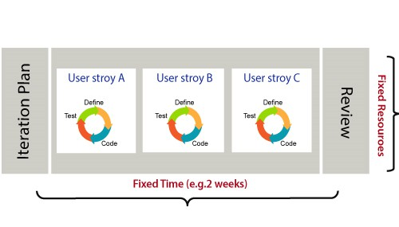
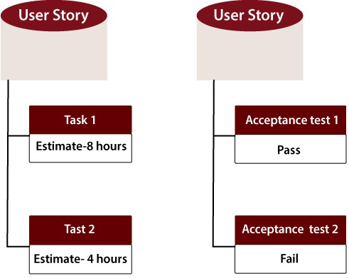
05-04-2025
How an Agile Team plan their work?
An Agile methodology is not a specific set of ceremonies or specific development techniques. Rather, it is a group of methodologies that demonstrate a commitment to tight feedback cycles and continuous improvement.
An Agile team works in iterations to deliver the customer requirement, and each iteration takes 10 to 15 days.
However, the original Agile Manifesto didn't set the time period of two-week iterations or an ideal team size.
Each user requirement is a planned based and their backlog prioritization and size.
The team decides, how much scope they have and how many hours available with each team to perform their planed task.
What is a user requirement?
The user requirement defines the requirements of the user in terms of functionalities. There may be of two type of functionality.
As a <User Role> I want <Functionality> so that <Business Value>
In order to <Business value> as a <User Role> I want <Functionality>.

Slide 13
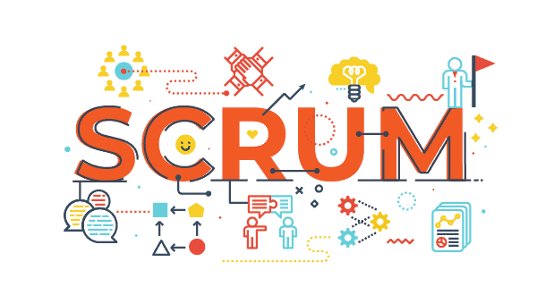
05-04-2025
What is Software Acceptance Criteria?
Acceptance Criteria is defined as the functionality, behavior, and performance required by a product owner.
It defines what is to be done so that the developer knows when a user
requirement is complete.

Slide 14
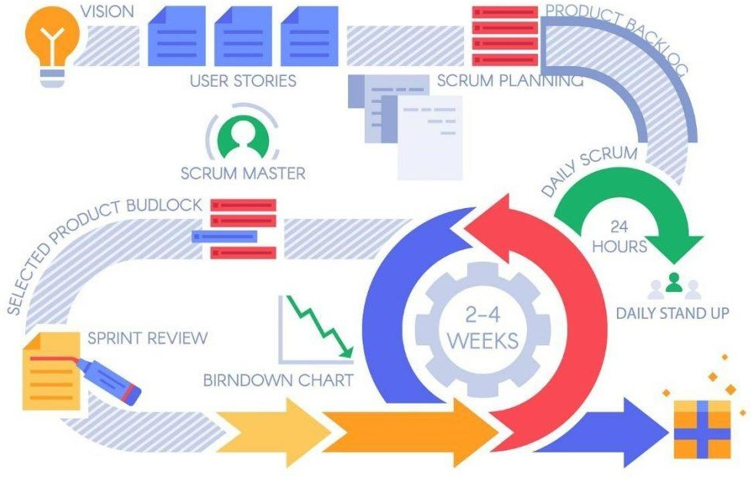
05-04-2025
Agenda
Agile Methodology SCRUM
Scrum is an agile development methodology used in the development of Software based on an iterative and incremental processes.
Scrum is adaptable, fast, flexible and effective agile framework that is designed to deliver value to the customer throughout the development of the project.
The primary objective of Scrum is to satisfy the customer’s need through an environment of transparency in communication, collective responsibility and continuous progress.
The development starts from a general idea of what needs to be built, elaborating a list of characteristics ordered by priority (product backlog) that the owner of the product wants to obtain.

Slide 15
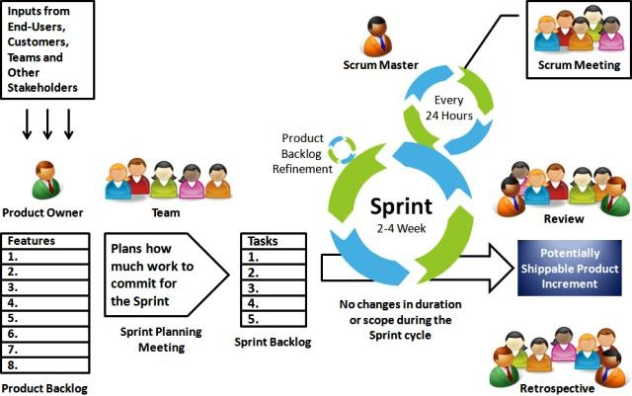
05-04-2025
Scrum Methodology & Process
Scrum is precisely an evolution of Agile Management.
Scrum methodology is based on a set of very defined practices and roles that must be involved during the software development process.
It is a flexible methodology that rewards the application of the 12 agile principles in a context agreed by all the team members of the product.
Scrum is executed in temporary blocks that are short and periodic, called Sprints, which usually range from 2 to 4 weeks, which is the term for feedback and reflection.
Each Sprint is an entity in itself, that is, it provides a complete result, a variation of the final product that must be able to be delivered to the client with the least possible effort when requested.

Slide 16
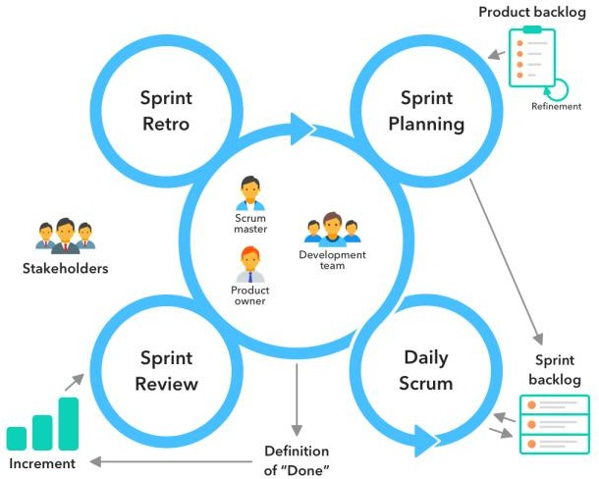
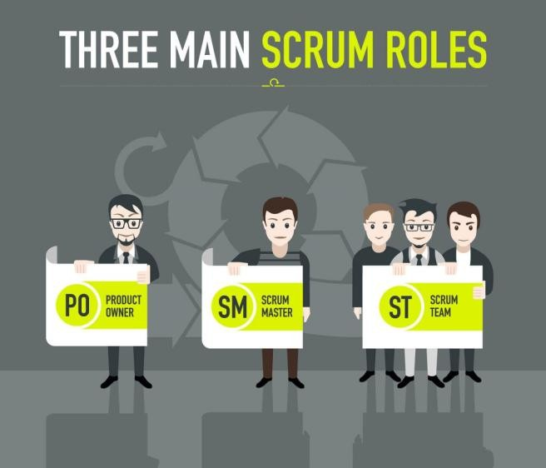
05-04-2025
What are sprints?
With scrum, a product is built in a series of repetition called sprints.
It breaks down big complex projects into bite-size pieces.
It makes projects more manageable, allows teams to ship high quality, work faster, and more frequently.
The sprints give them more flexibility to adapt to the changes.
Sprints are a short, time-boxed period for Scrum team that works to complete a set amount of work.
Sprints are the core component of Scrum and agile methodology.
The right sprints will help our agile team to ship better software.
Scrum master:
Scrum master: The person who leads the team guiding them to comply with the rules and processes of the methodology.
Scrum master manages the reduction of impediments of the project and works with the Product Owner to maximize the ROI.
The Scrum Master is in charge of keeping Scrum up to date, providing coaching, mentoring and training to the teams in case it needs it.

Slide 17
05-04-2025
Product owner (PO):
Product owner (PO): Is the representative of the stakeholders and customers who use the software.
They focus on the business part and is responsible for the ROI of the project.
They Translate the vision of the project to the team, validate the benefits in stories to be incorporated into the Product Backlog and prioritize them on a regular basis.
Team:
Team: A group of professionals with the necessary technical knowledge who develop the project jointly carrying out the stories they commit to at the start of each sprint.

Slide 18
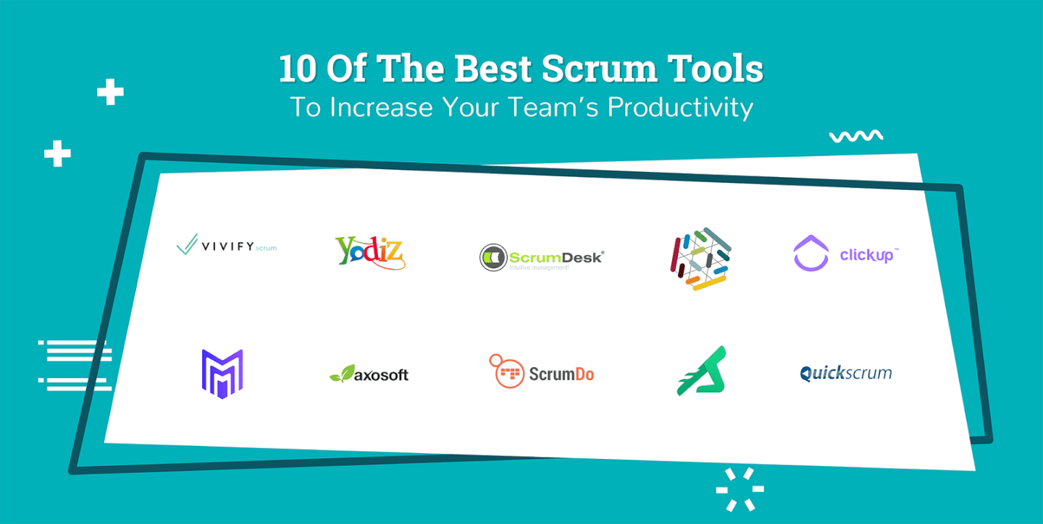
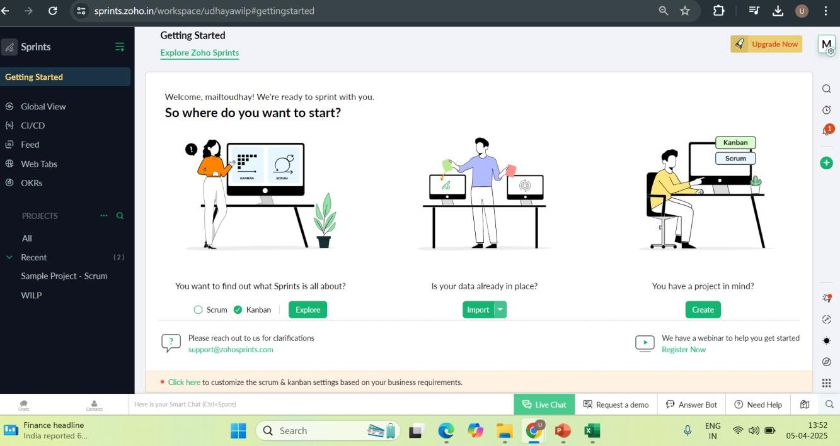
05-04-2025

Slide 19
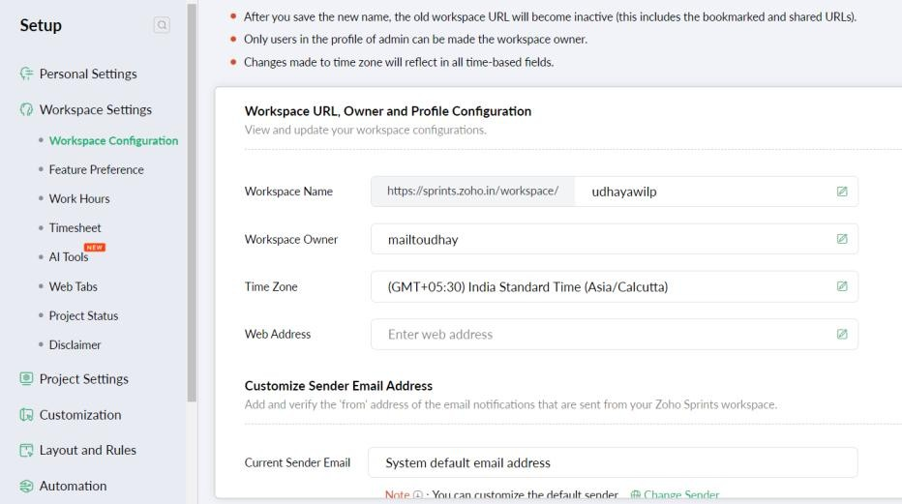
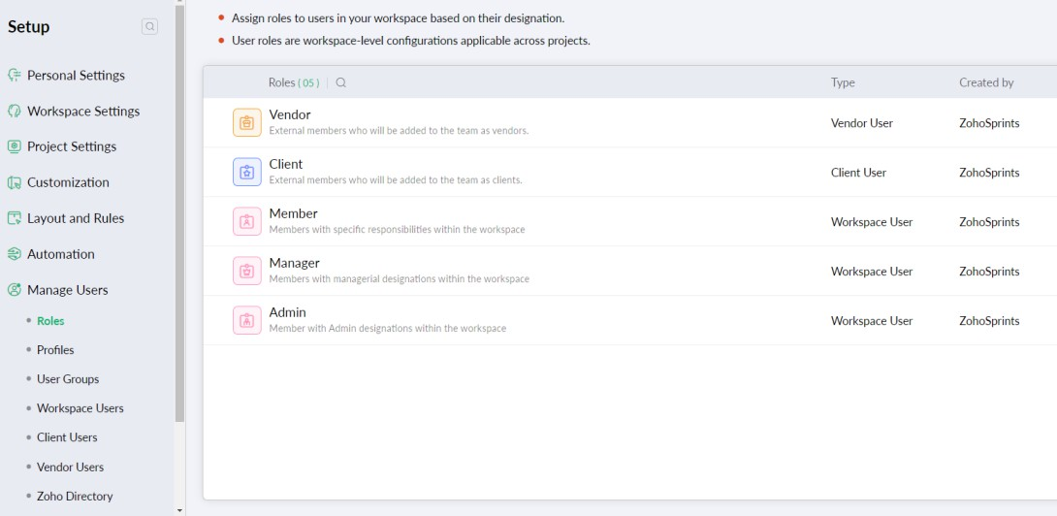
05-04-2025
In Zoho Sprint- Perform Workspace config
Manage users→ Users and Roles

Slide 20
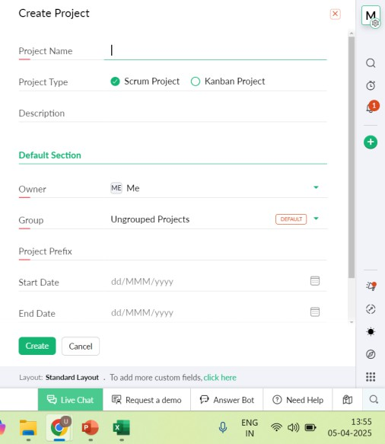
05-04-2025

Slide 21
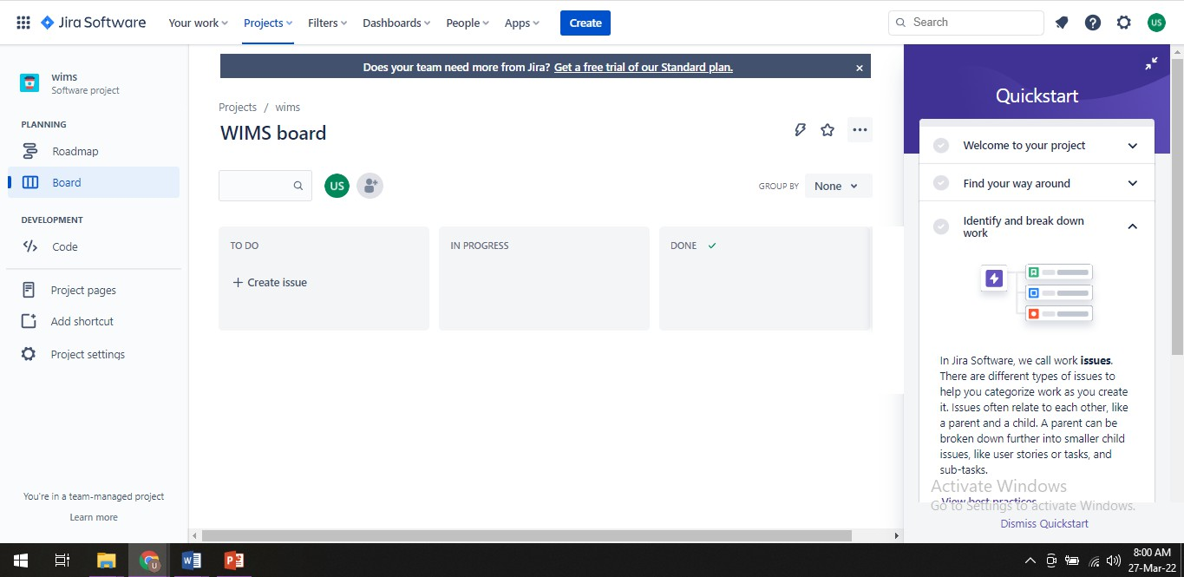
05-04-2025
https://youtu.be/GWxMTvRGIpc

Slide 22
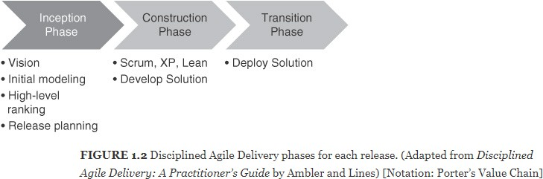
05-04-2025
Agenda
DevOps and Agile
Relationship of DevOps practices to agile practices
DevOps Practices over Agile
Traditional, Agile and DevOps – A comparison
DevOps and Agile
Relationship of DevOps practices to agile practices
One of the characterizations of DevOps emphasizes the relationship of DevOps practices to
agile practices
We will focus on what is added by DevOps
We interpret transition as deployment

Slide 23



05-04-2025
DevOps and Agile Contd..
DevOps Practices over Agile
DevOps practices impact all three phases
Inception phase : During the inception phase, release planning and initial requirements specification are done
Considerations of Ops will add some requirements for the developers
Release planning includes feature prioritization but it also includes coordination with operations
personnel
Construction phase: During the construction phase, key elements of the DevOps practices are the management of the code branches,
the use of continuous integration
continuous deployment
incorporation of test cases for automated testing
Transition phase: In the transition phase, the solution is deployed and the development team is responsible for the deployment, monitoring the process of the deployment, deciding whether to roll back and when, and monitoring the execution after deployment
DevOps and Agile Contd..
Traditional, Agile and DevOps – A comparison
Agile breaks the wall between Business and Development team
DevOps breaks the wall between Development and Operations team
DevOps centers on the concept of sharing: sharing ideas, issues, processes, tools and goals
Business
Design
Code
QA
Operations
Inception
Elaboration
Construction
Transition
Elaboration
Construction
Transition
Operations

Slide 24
05-04-2025
Agenda
Agile methodology for DevOps Effectiveness
Why DevOps Process?
DevOps Process: Flow based vs Non flow based
DevOps Process: Component team vs Feature Team
DevOps Process
Why DevOps Process?
We need processes and policies for doing things in a proper way and standardized across the projects so the sequence of operations, constraints, rules and so on are well defined to measure success
We need to set processes for the following things:
Agile planning
Resource planning and provisioning
Configuration management
Role-based access control to cloud resources and other tools used in automation
Static code analysis – rules for programming languages
Testing methodology and tools
Release management

Slide 25
05-04-2025
Agile methodology for DevOps Effectiveness
Flow based and Non flow based
Non-Flow Based
VS
Flow Based
Extreme Programming
SCRUM
KANBAN
Feature Driven Development
Hybrid Agile
DevOps Process
Selecting a Teams Structure
Choosing appropriate team structure (Resource planning)
Component Team Structure
Featured Team Structure

Slide 26







05-04-2025
DevOps Process
Component teams
Made up of experts that specialize in a specific domain
Architecture diagram can be represented as layer of the system
Advantages:
work is always done by people specifically qualified to do the work
work is done efficiently with a low defect density
Team1 (UI)
Team2 (Business logic) Team3 (DB)
Architecture diagram
DevOps Process
Component teams Disadvantages
Working as Component Teams increases the amount of time it
takes to deliver
working in Component Teams will have a negative effect on productivity that cannot be over emphasized
(Example: if business logic team starts on a piece of work, For them to complete the work, they need to define the interface between their layer and the other layers)
Running Component Teams leaves us vulnerable to the risk that they will have to perform non-optimum work at the expense of items that are more valuable to the business
Team1 (UI)
Team2 (Business logic)
Team3 (DB)
Interface

Slide 27
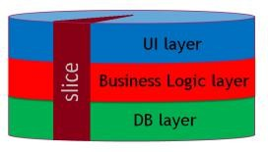
05-04-2025
DevOps Process
Feature Teams
Feature Teams contain multi-disciplined individuals that have the ability and freedom to work in any area of the system
Feature Team usually has at least one member with specialist knowledge for each layer of the system
This allows Feature Teams to work on what are known as ‘vertical slices’ of the architecture
DevOps Process
The characteristics of a feature team
long-lived—the team stays together so that they can ‘jell’ for higher performance; they take on
new features over time
cross-functional and cross-component
co-located
work on a complete customer-centric feature, across all components and disciplines (analysis, programming, testing, …)
composed of generalizing specialists
in Scrum, typically 7 ± 2 people

Slide 28
05-04-2025
DevOps Process
Feature Team Disadvantages
What if untrained or inexperienced employee to deliver a poorly designed piece of work into a live environment
Where do you get the personnel (‘generalizing specialists’)?
DevOps Process
DevOps – Process: Summary on How do you structure your teams
Preferred
Component Teams
Feature
Teams
Component Based structure
Mostly aligned to technology cluster
Faster component Development
Slower feature realization
Integration nightmare
Suitable for platform teams
Business Feature Based structure
aligned to business domains
Faster feature realization
Scale-up problem due to need of cross-functional team
Full-stack engineer
Lower hand-off

Slide 29
05-04-2025
References
https://www.agil8.com/blog/component-teams-vs-feature-teams/
Agenda
Agile Methodologies
Test Driven Development
Feature Driven Development
Behavior Driven Development

Slide 30
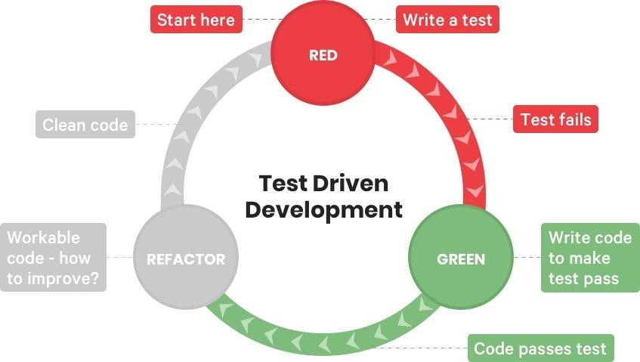
05-04-2025
TDD
TDD Introduction
Kent Beck said “Test-first code tends to be more cohesive and less coupled than code in which testing isn’t a part of the intimate coding cycle”
“If you can’t write a test for what you are about to code, then you shouldn’t even be thinking
about coding”
TDD
TDD Three steps
RED
Write a new TEST which fails
GREEN
Write simplest possible code to make it succeed
REFACTOR
Refactor the code (including test code)

Slide 31

05-04-2025
TDD
TDD Technique
TDD is a technique whereby you write your test cases before you write any implementation code
TDD
TDD Overview
Write a test
Refactor the code
Compile
Run test watch it pass
Fix Compile error
Write code
Run test, watch it fail

Slide 32
05-04-2025
TDD
TDD Overview Contd..
How It Works:
Add a Test
Use Cases / User Stories are used to understand the requirement clearly
Run all tests and see the new one fail
Ensures test harness is working correctly
Ensures that test does not mistakenly pass
Write some code
Only code that is designed to pass the test
No additional functionality should be included because it will be untested
Run the automated tests and see them succeed
If tests pass, programmer can be confident code meets all tested requirements
Refactor code
Cleanup the code
Rerun tests to ensure cleanup did not break anything
Repeat
TDD
TDD Overview Contd..
In Extreme Programming Explored (The Green Book), Bill Wake describes the test / code cycle:
Write a single test
Compile it. It shouldn’t compile because you’ve not written the implementation code
Implement just enough code to get the test to compile
Run the test and see it fail
Implement just enough code to get the test to pass
Run the test and see it pass
Refactor for clarity and “once and only once”
Repeat

Slide 33

05-04-2025
TDD
Why TDD
TDD can lead to more modularized, flexible, and extensible code
Clean code
Leads to better design
Better code documentation
More productive
TDD
Test First vs. Test Last
User Story
User Story
Understand
Understand
Add a test case
Implementation
Write code
Write the tests for story
Run all tests
Run all tests
Rework
P
Rework
P
F
Result?
No
F
Result?
Story completed?
Next story
Yes
Next story

Slide 34
05-04-2025
Feature Driven Development
FDD History
Original Creator: Jeff De Luca
Singapore in late 1997
FDD evolved from an actual project
Bank Loan Automation
Luca was Project manager
50 member developer team
Peter Coad : Chief Architect
1990’s object-oriented analysis and design expert
FDD
What is a Feature?
Definition: small function expressed in client-valued terms
FDD’s form of a customer requirement

Slide 35
05-04-2025
FDD
FDD Primary Roles
Project Manager
Chief Architect
Development Manager
Domain Experts
Class Owners
This concept differs FDD over XP
Benefits
Someone responsible for integrity of each class
Each class will have an expert available
Class owners can make changes much quicker, if needed anytime
Easily lends to notion of code ownership
Assists in FDD scaling to larger teams, as we have one person available for complete ownership of feature.
Chief Programmers
FDD
FDD Supporting Roles
Release Manager
Language Guru
Build Engineer
Toolsmith
System Administrator
Tester
Deployers
Technical Writer

Slide 36
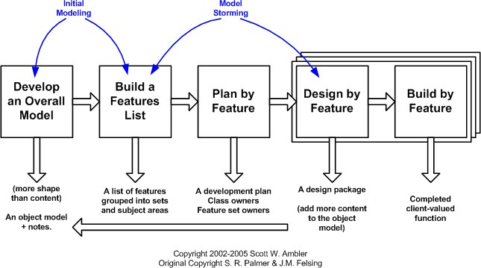
05-04-2025
FDD
Feature Driven Development Process
Process #1: Develop an Overall Model
Process #2: Build a Features List
Process #3: Plan By Feature
Constructing the initial schedule, Forming level of individual features, Prioritizing by business value ,
As we work on above factors we do consider dependencies, difficulty, and risks.
These factors will help us on Assigning responsibilities to team members, Determining Class Owners , Assigning feature sets to chief programmers
Process #4: Design By Feature
Goal: not to design the system in its entirety but instead is to do just enough initial design that you are able to build on
This is more about Form Feature Teams: Where team members collaborate on the full low level analysis and design.
Process #5: Build By Feature
Goal: Deliver real, completed, client-valued function as often as possible
FDD
Feature Driven Development Process Contd..

Slide 37
05-04-2025
Behavior Driven Development
BDD Introduction
Behavior-Driven Development (BDD) is a software development process
BDD is considered an effective technical practice especially when the "problem space" for the business is complex
What is BDD?:
General Technique of TDD
Follows same principle as TDD
Shared tools
Shared Process
BDD
BDD Focus
Where to start in the process
What to test and what not to test
How much to test in one go
What to call the tests
How to understand why a test fails
Write failing acceptance test
Write failing unit test
Write failing unit test
Refactor the code
Refactor the code
BDD
TDD

Slide 38
05-04-2025
BDD
BDD Basic structure
BDD consists of cycles of a set of steps to follow.
Identify business feature
Identify scenarios under the selected feature
Define steps for each scenario
Run feature and fail
Write code to make steps pass
Refactor code, Create reusable automation library
Run feature and pass
Generate test reports
BDD
BDD Example
User story:
As someone interested in using the Mobile app, and want to sign up in app to enjoy app membership
Mobile App Signup:
Scenario 1:
Given that I am on the app's "Create new account" screen
Then I should see a "Sign up using Facebook" button
And I should see a "Sign up using Twitter" button
And I should see a "Sign up with email" form field
Then I should see a new screen that asks permission to use my Facebook account data to create my new Mobile app account

Slide 39
05-04-2025
BDD
BDD Sign Use
Functional Documentation in terms of User Stories & Executable Scenarios
Instead of referring to "tests", a BDD practitioner will prefer the terms "scenario" and "specification"
Rather than refer to "functional tests", the preferred term will be "specifications of the product's
behavior"
Specification Names are more expressive
References
http://agilemodeling.com/

Slide 40
05-04-2025
Agenda
DevOps – People
DevOps Team Structure
Team Coordination
Team Structure
Team Size
The size of the team should be relatively small
Amazon has a “two pizza rule”
That is, no team should be larger than can be fed from two pizzas
The advantages of small teams are
They can make decisions quickly
It is easier for individuals to express an opinion
It is easier for individuals to express an idea in front of a small group than in front of a large one
The disadvantage
Some tasks are larger than can be accomplished by a small number of individuals
Task has to be broken up into smaller pieces
A small team, by necessity, works on a small amount of code

Slide 41
05-04-2025
Team Structure
Team Roles
We will study roles in the team from Scott Ambler’s description of roles in an agile team
Team lead :
This role you can relate to “Scrum Master” of SCRUM TEAM.
Also you can relate to Project Lead
Is responsible:
For facilitating the team
Obtaining resources for it
And protecting it from problems
This role encompasses the soft skills of project management but not the technical ones such as planning and scheduling, activities which are better left to the team as a whole.
Team member
This role, sometimes referred to as developer or programmer
Is responsible for the creation and delivery of a system
This includes modeling, programming, testing, and release activities, as well as others
Team Structure
Additional roles
Service owner
Reliability engineer
Gatekeeper
And DevOps engineer

Slide 42
05-04-2025
Team Structure
Service Owner
This role on the team responsible for outside coordination
The service owner participates:
System-wide requirements activities
Prioritizes work items for the team
And provides information both from the clients of the team’s service and about services provided to the
team.
The requirements gathering and release planning activities for the next iteration can occur in parallel with the conception phase of the current iteration
The service owner maintains and communicates the vision for the service
That is, the vision involves the architecture of the overall system and the team’s role in that architecture
Team Structure
Reliability Engineer
Reliability engineer monitors the service in the time period immediately subsequent to the
deployment
Second, the reliability engineer is the point of contact for problems with the service during its execution
Google calls this role “Site Reliability Engineer.”
Once a problem occurs, the reliability engineer performs short-term analysis to diagnose, mitigate, and repair the problem
In any case, the reliability engineer has to be excellent at troubleshooting and diagnosis
The reliability engineer should discover or work with the team to discover the root cause of a problem
Increasingly, reliability engineers need to be competent developers, as they need to write high-
quality programs to automate the repetitive part of the diagnosis, mitigation, and repair

Slide 43
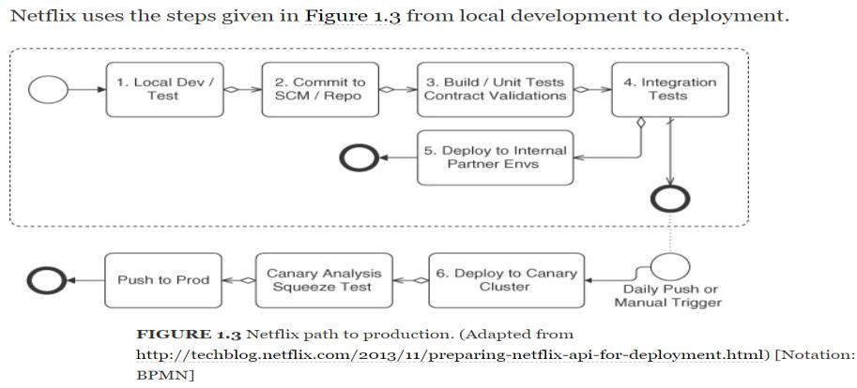
05-04-2025
Team Structure
Gatekeeper
Team Structure
DevOps Engineer
The DevOps engineer role is responsible for the care and feeding of the various tools used in
the DevOps tool chain
The DevOps engineer’s role, as are the tailoring of the tool for the development team and monitoring
The DevOps engineering role is inherent in automating the development and deployment pipeline
DevOps engineer also deals with configuration managements tools which are like Puppet, Ansible and Chef etc.
These configuration management solutions are applied to the source code for the service

Slide 44
05-04-2025
Team Coordination
Forms of Coordination
One goal of DevOps is to minimize coordination in order to reduce the time to market
Two of the reasons to coordinate are, first, so that the pieces developed by the various teams will work together and, second, to avoid duplication of effort
Forms of Coordination
Direct—the individuals coordinating know each other (e.g., team members)
Indirect—the coordination mechanism is aimed at an audience known only by its characterization (e.g. Operators)
Persistent—the coordination artifacts are available after the moment of the coordination (e.g., documents, e-mail, bulletin boards)
Ephemeral—the coordination, per se, produces no artifacts (e.g., face to face meetings, conversations, telephone/video conferencing)
Synchronous—individuals are coordinating in real time, (e.g., face to face)
Asynchronous—individuals are not coordinating in real time (e.g., documents, e-mail)
Team Coordination
Team coordination mechanisms
Team coordination mechanisms are of two types
Human Processes and
Automated Processes
The DevOps human processes are adopted from agile processes and are designed for high- bandwidth coordination with limited persistence
Examples: Stand-up meetings
Automated team coordination mechanisms are designed to protect team members from interference of their and others’ activities:
To automate repetitive tasks (continuous integration and deployment),
And to speed up error detection and reporting (automated unit, integration, acceptance, and live production tests)

Slide 45
05-04-2025
Team Coordination
Cross-team Coordination
Coordination must occur with customers, stakeholders, other development teams, and operations. Therefore, DevOps processes attempt to minimize this coordination as much as possible
There are three types of cross-team coordination:
Upstream Coordination [with stakeholders and customers]
Downstream Coordination [with operations]
And Cross-Stream Coordination [with other development teams]
There are two reasons for a development team to coordinate with other development teams
To ensure that the code developed by one team works well with the code developed by another
And to avoid duplication of effort
Agenda
DevOps People
Transformation to Enterprise DevOps culture

Slide 46
05-04-2025
Transformation to Enterprise DevOps culture
Constraints of Large Enterprise :: DevOps Transformation
Organization Structure
Legacy Technology Stack
Organization Culture
Transformation to Enterprise DevOps culture
Concepts
Executives do not like terms such as “Transformation”
Somehow it is often interpreted as:
Cost Cutting or
Resource Realignment or
Outsourcing
Why organizations are pushing to be DevOps
The intent is to transform the way solutions are being delivered today and to do it faster, cheaper and better
The techniques of Agile and DevOps have been successfully implemented in many large and small organizations to enable those outcomes
Look in to the approach that worked quite well for most enterprises

Slide 47





05-04-2025
Transformation to Enterprise DevOps culture
Initial Planning for Enterprise Readiness
Participants should absolutely include all the towers that make up the solution delivery
Design Thinking : It is a great method; it leverages the expertise of all stakeholders, enables them to come to a common understanding
High Level Output
Participant & Inputs
Design Thinking
High Level Outputs
Transformation to Enterprise DevOps culture
Establish a DevOps Center of Excellence
At the right organizational level and enterprise authority
Create a Face: It has to be led by an enterprise leader who has the support and buy-in from all the towers
Active Participant from All Towers of Delivery & Participants must be chosen wisely
These phases help concrete the vision and strategies of organization and help in setup the best practices to support cultural movement
Authority
Create a Face
Involve All

Slide 48


05-04-2025
Transformation to Enterprise DevOps culture
Establish Program Governance
Agile and DevOps, practitioners’ roles and responsibilities will change
Need awareness, enablement and empowerment to succeed
KPIs must shift from individual metrics to holistic customer business outcomes
Create Communication Plan
Enablement
Program
Establish
Program KPI’s
Transformation to Enterprise DevOps culture
Establish Project In-take Process
DevOps SME’s conduct in-take workshops for Scrum Teams
Automation scripts, Infrastructure assets
Test Automation, Branching and Merging & Lessons Learned
Fit for purpose tool selection and Application Criticality
Reusable Assets
Best Practices
Right Sizing

Slide 49
05-04-2025
Transformation to Enterprise DevOps culture
Identify and Initiate Pilots
Value stream-mapping exercise
Level of detail necessary:
To identify end to end as-is process, tooling, manual and automated processes
And skills and people
Transformation to Enterprise DevOps culture
Scale Out DevOps Program
Onboard Parallel Release Trains
Apply Intake Process
Support, Monitor and Manage

Slide 50
05-04-2025
References
I would like to thank you Mr. Sunil Joshi
https://devops.com/six-step-approach-enterprise-devops-transformation/
DevOps People Dimension
DevOps is a culture
People
DevOps is a cultural movement; it’s all about people
Building a DevOps culture, therefore, is at the core of DevOps adoption
An organization may adopt the most efficient processes or automated tools possible, but they’re useless without the people who eventually must execute those processes and use those tools
DevOps culture is characterized by a high degree of collaboration across roles, focus on business instead of departmental objectives, trust, and high value placed on learning through experimentation
Building a culture isn’t like adopting a process or a tool
It requires social engineering of teams of people, each with unique predispositions, experiences,
and biases
This diversity can make culture-building challenging and difficult
Lean and agile transformation practices are at the core of DevOps

Slide 51
05-04-2025
DevOps People Dimension
Managing People, Not Resources
“Managing teams would be easy if it wasn’t for the people you have to deal with”
Some people react allergically when you call people resources and talk about managing resources
A resource is something you can manage without much tailoring
For an Example: you can treat one bag of sand like the next bag of sand when it comes to
making dikes
With people, that is never true
For an Example: We have probably all been planning for projects and creating a plan that includes a certain amount of “anonymous full-time equivalents (FTEs).” Then a bit later, we start putting names to it and realize that we need more or less effort based on the actual people we have available for the project
One Java developer is just not the same as another; and honestly, we would never consider ourselves to be just a resource whose job someone else could do with the same efficiency and effectiveness
DevOps People Dimension
Don’t change Organization; Change yourself
You will not be able to get the organization to change
But what you can do is change your part of the organization
Manage your teams the way that you would like to be treated
As you climb higher in the hierarchy, your area of influence will increase and, with that, a larger and larger part of the organization will work the way you would like it to

Slide 52
05-04-2025
DevOps People Dimension
Identifying Business Objective
Getting everyone headed in the same direction
And working toward the same goal
“Identify Common Business Objective for the Team and Organization”
Incent the entire team based on business outcomes versus conflicting team incentives
Easy to measure progress of goal for team and organization
DevOps isn’t the goal. It helps you reach your goals
DevOps People Dimension
Effective Management of People
One-On-Ones
Regular one-on-one meetings with the people who report directly to you
Don’t be Anonymous
Having an open-door policy is NOT the same as setting up one-on-ones
Let feel people are important to you
You are making time for them
Best Practices : have weekly or bi weekly 30 minutes one-on –one, learn more about person, let them raise first and provide your updates
Benefit to Manager?
Benefit to Employee?
Feedback
Everyone would like to get more feedback from his or her boss
Dan Pink’s mastery, autonomy, and purpose : “When you do x, y happens, which is not optimal. Can you find a way to do it differently next time to lead to a better outcome? “
Focus on feedback?

Slide 53
05-04-2025
DevOps People Dimension
Effective Management of People Contd..
Delegation
Feel on delegation of JOB to others?
Managerial Economics 101
Creating a Blameless Culture
Who is being blamed?
You will have to cover it without delegating the blame to the person in your team who is responsible
The team will appreciate this
The more you share with the rest of the organization the positive impact a member of your team has made, the better you will look too
These two practices empower the people on your team to do the best job they can for you
Whenever you have failures or problems, your root-cause analysis should not focus on who did what but on how we need to change the system so that the next person is able to avoid making the mistake again
DevOps People Dimension
Effective Management of People Contd..
Measuring Your Organizational Culture
There are a few different ways to measure culture
The Westrum survey measures
On my team, information is actively sought.
On my team, failures are learning opportunities, and messengers of them are not punished.
On my team, responsibilities are shared.
On my team, cross-functional collaboration is encouraged and rewarded.
On my team, failure causes inquiry.
On my team, new ideas are welcomed
There are few more suggestions:
I would recommend the team to my friends as a good place to work.
I have the tools and resources to do my role well.
I rarely think about leaving this team or my company.
My role makes good use of my skills and abilities.
Remember that advice stated before: you can only control your part of the organization

Slide 54
05-04-2025
DevOps People Dimension
Effective Management of People : Lets Summarize
Measuring Your Organizational Culture
Provide your employees:
An organizational structure
The business context and
The necessary feedback
People are factor that makes transformation succeed or fail
Spend enough time and effort on People during the transformation
Agenda
Tools and Technology in DevOps
What is DevOps Tools
Local Development Environment
Version Control
Artifact Management
Automation
Monitoring
Evolution of the Ecosystem

Slide 55
05-04-2025
DevOps Tools
What is DevOps Tools:
What is DevOps Tools:
Tools can be used to improve and maintain various aspects of culture
Software development tools help with the process of programming, documenting, testing, and fixing bugs in applications and services
Not restricted to specific roles, these tools are important to anyone who works on software in
some capacity
Local development environment,
Version control,
Artifact Management,
Automation and Monitoring
DevOps Tools
Local Development Environment
A consistent local development environment is critical to quickly get employees started
contributing to product
Don’t Consider this as limitation:
This is not to say that individuals should be locked into a single standard editor with no flexibility or customization, but rather it means ensuring that they have the tools needed to get their jobs done effectively
Minimal requirements may vary in your environment depending on individual preferences:
Multiple Displays
High-Resolution Displays
Specific Keyboards, Mice, and other Input Devices
Identify a shared area for documenting the local development environment
Documentation can be stored within a version control repository, an internal wiki, or even a Google Doc

Slide 56

05-04-2025
DevOps Tools
Version Control
Having the ability to commit, compare, merge, and restore past revisions of objects to the repository allows for richer cooperation and collaboration within and between teams
Version control enables teams to deal with conflicts that result from having multiple people working on the same file or project at the same time, and provides a safe way to make changes and roll them back if necessary
When choosing the appropriate version control system (VCS) for your environment, look for one that encourages the sort of collaboration in your organization that you want to see
Opening and forking repositories;
Contributing back to repositories;
Curating contributions to your own repositories;
Defining processes for contributing; and
Sharing commit rights
Your Wrong Ways may be:
Lines of code is not an accurate measure of value
DevOps Tools
Artifact Management
An artifact is the output of any step in the software development process
When choosing between a simple repository and more complex feature-full repository, understand the cost of supporting additional services as well as inherent security concerns
An artifact repository should be:
Secure;
Trusted;
Stable;
Accessible; and
Versioned
You can store a versioned common library as an artifact separate from your software version control, allowing all teams to use the exact same shared library

Slide 57
05-04-2025
DevOps Tools
Automation
Automation tools reduce labor, energy, and/or materials used with a goal of improving quality, precision, and accuracy of outcomes
Server Installation
Server installation is the automation of configuring and setting up individual servers
Infrastructure Automation
Configuration Management
Capacity Management
System Provisioning
Test and Build Automation
On-demand automation
Scheduled automation
Triggered automation
Smoke testing
Regression testing
Usability testing
DevOps Tools
Monitoring
Metrics
Metrics are the collection of qualitative and quantitative measurements
Generally they are compared against some benchmark or established standard, tracked for analytics, or tracked for historical purposes
Logging
Logging is the generation, filtering, recording, and analysis of events that occur on a system due to operating system or software messages
When tracking down the source of a software issue, one of the first things that engineers often do is to check the logs for any relevant error messages
A single system can generate hundreds or even thousands of lines of logs a day
Alerting
Monitoring and alerting are important not only from a performance perspective, but also from a preventative one, in that they help you find out about potential issues before they become actual issues for your customers

Slide 58
05-04-2025
DevOps Tools
Monitoring Contd..
Events
Event management is the element of monitoring that acts on existing knowledge around impacts to systems and services
This generally reflects the need for real-time information about the status of all of the different components of infrastructure
A system is configured to monitor a specific metric or log based on a defined event and to signal or alert if a threshold is crossed or an alert condition has been met
Many alerting and monitoring systems have built-in ways to automatically respond to a given event
Nagios, Zabbix, etc.
DevOps Tools
Evolution of the Ecosystem
There is a trend to simplify and remove the repetitive tasks that can be subject to human error
As automation is added to the different parts of the environment, new patterns are discovered
Continuous delivery and continuous deployment have freed humans up to focus on what matters
Automated shortened feedback cycles through build automation with tests give us additional confidence and insight into our systems
The ecosystem will continue to evolve as application development adopts increased operability
These trends bring into focus the tools that stress the “we” over “me,” building understanding across teams and encouraging time spent on valuable outcomes

Slide 59
05-04-2025
DevOps Tools
Summarize
We have been through an overview of the current ecosystem of tools
How tools are used, and the ease with which they can be used, impacts the acceptance and proliferation of specific aspects of culture
The DevOps culture is one of collaboration across teams, organizations, and industries
When developing solutions, it is important to think about their impact on teams and
organizations, not just individuals
DevOps tools stress “we” over “me”; they allow teams and organizations to build mutual understanding to get work done
Agenda
Cloud as a catalyst for DevOps
Introduction
Characterization of the cloud
Cloud services

Slide 60
05-04-2025
Cloud as a Catalyst for DevOps
Introduction
Unfortunately for many organizations, the cloud is still somewhat mysterious
Not the concept of the cloud but why they are not seeing the benefits that were promised to them
The focus is on adopting cloud-based infrastructure and managing it
While we will discuss cost benefits primarily, one should not forget the other benefits and risks of the cloud
Benefits:
Redundancy for resilience
The scalability of resources
The strong ecosystem of related
Risks:
The dependency on a third-party provider
The challenges with data sovereignty
Risk of being attacked because you are on a popular platform
Cloud as a Catalyst for DevOps
Characterization of the cloud
Characterization of the cloud by National Institute of Standards and Technology (NIST)
On-demand self-service
Broad network access
Resource pooling
Rapid elasticity
It is the Capabilities can be elastically provisioned and released
Measured service
Software as a Service (SaaS)
Platform as a Service (PaaS)
Infrastructure as a Service (IaaS)

Slide 61
05-04-2025
Cloud as a Catalyst for DevOps
Software as a Service (SaaS)
In this the consumer is provided the capability to use the provider’s applications running on a cloud infrastructure
The applications are accessible from various client devices through either a thin client interface, such as a web browser (e.g., web-based e-mail) or an application interface.
The consumer does not manage or control the underlying cloud infrastructure including
networks, servers, operating systems, storage.
For an example, you can relate google apps, Cisco WebEx, as a Service, Office 365 service, where Provider deals with the licensing of software’s
Cloud as a Catalyst for DevOps
Platform as a Service (PaaS)
The consumer is provided the capability to deploy onto the cloud infrastructure consumer- created or acquired applications created using programming languages, libraries, services, and tools supported by the provider
The consumer does not manage or control the underlying cloud infrastructure including networks, servers, operating systems, or storage, but consumer has control over the deployed applications and possibly configuration settings for the application-hosting environment
For an Example: .NET Development platform is considered as a platform

Slide 62
05-04-2025
Cloud as a Catalyst for DevOps
Infrastructure as a Service (IaaS),
The consumer is provided the capability to provision processing, storage, networks, and other fundamental computing resources where the consumer is able to deploy and run arbitrary software, which can include operating systems and applications
The consumer does not manage or control the underlying cloud infrastructure but consumer has control over operating systems, storage, and deployed applications; and possibly limited control of select networking components (e.g., host firewalls). For this you can consider any Server Provisioning is IaaS,
Cloud as a Catalyst for DevOps
Summary
The cloud has emerged as a major trend in IT during recent years
Its characteristics include metered usage (pay-per-use) and rapid elasticity, allowing the scaling out of an application to virtually infinite numbers of VMs
The cloud rests on a platform that is inherently distributed and exploits virtualization to allow rapid expansion and contraction of the resources available to a given user
From an operational perspective, controlling the VMs, managing different database management systems, and ensuring the environments meet the needs of the development and operations tasks are new considerations associated with the cloud

